Slide 1
Presentation for the CCL meeting Prefrontal cortex as a meta-reinforcement learning system
Jianyong
17/05/2022

Slide 2
Objectives
Understanding the RNN+RL structure in PFC, and their implementation details.
Integrating studies on the function of PFC and draw an integrated picture of it, also answer an additional question that does the deep meta-reinforcement learning is the only way to explain these functions?
The possible applications of what can we do with it in contextual controlled learning for problem-solving

Slide 3
Introduction
Phasic dopamine (DA) release is interpreted as conveying a reward prediction error (RPE) that drives synaptic plasticity in the striatum, translating experienced action-reward associations into optimized behavioral policies.
However, a growing body of evidence suggests that PFC implements mechanisms for reward-based learning, performing computations that strikingly resemble those ascribed to DA-based RL.
Sectors of the PFC represent the expected values of actions, objects and states. More recently, it has emerged that PFC also encodes the recent history of actions and rewards.
In short, neural activity in PFC appears to reflect a set of operations that together constitute a self-contained RL algorithm. The dopamine system trains the prefrontal cortex to operate as its own free-standing learning system.

Slide 4
The relationship between PFC and DA RL systems
DA and PFC subserve different forms of learning, with DA implementing model-free RL, based on direct stimulus–response associations, and PFC performing model-based RL, which leverages internal representations of task structure.
However, DA prediction-error signals are informed by task structure, reflecting “inferred” and “model-based” value estimates that are difficult to square with the standard theory as originally framed.

Slide 5
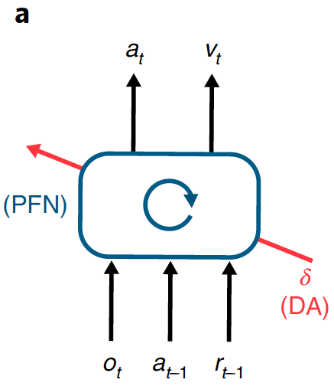
System architecture
This network’s inputs include perceptual data, which either contains or is accompanied by information about executed actions and received rewards. On the output side, the network triggers actions and also emits estimates of state value.
Agent architecture. The prefrontal network (PFN) is modeled as a recurrent neural network, with synaptic weights adjusted through an RL algorithm driven by DA; o is perceptual input, a is action, r is reward, v is state value, t is time-step and δ is RPE. The central box denotes a single, fully connected set of LSTM units.

Slide 6
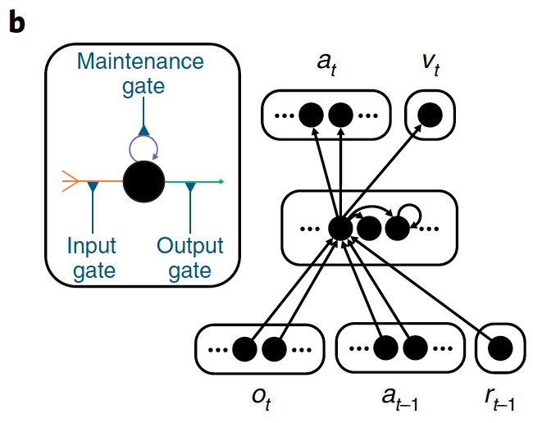
Detailed schematic of the neural network
Input units encoding the current observation and previous action and reward connect all-to-all with hidden units, which are themselves fully connected LSTM units.
These units connect all-to-all, in turn, with a softmax layer encoding actions and a single linear unit encoding estimated state value.
Inset: a single LSTM unit. Input (orange) is a weighted sum of other unit outputs, plus the activity of the LSTM unit itself (purple). Output (green) puts these summed inputs through a sigmoid nonlinearity. All three quantities are multiplicatively gated (blue).

Slide 7
Learning
The synaptic weights in the prefrontal network are adjusted by a model-free RL procedure, in which DA conveys a RPE signal. Via this role, the DA-based RL procedure shapes the activation dynamics of the recurrent prefrontal network.
Specifically, by adjusting the connection weights in the prefrontal network, DA-based RL creates a second RL algorithm, implemented entire in the prefrontal network’s activation dynamics.
This new learning algorithm is independent of the original one and differs in ways that are suited to the task environment.
Crucially, the emergent algorithm is a full-fledged RL procedure: it copes with the exploration–exploitation tradeoff, maintains a representation of the value function, and progressively adjusts the action policy.

Slide 8

Task environment
On each trial, the system outputs an action: left or right. Each has a probability of yielding a reward, but these probabilities change with each training episode, thus presenting a new bandit problem.
After training on a series of problems, the weights in the recurrent network are fixed and the system is tested on further problems.
The network explores both arms, gradually homing in on the richer one, learning with an efficiency that rivals standard machine-learning algorithms.

Slide 9
Neurobiological interpretation
DA, as in the standard model, broadcasts an RPE signal, driving synaptic learning in the prefrontal network. The principal role of this learning is to shape the dynamics of the prefrontal network by tuning its recurrent connectivity.
Through meta-RL, these dynamics come to implement a second RL algorithm, which differs from the original DA-driven algorithm, assuming a form tailored to the task environment.
The role of DA-driven RL, under this account, plays out across extended series of tasks. Rapid within-task learning is mediated primarily by the emergent RL algorithm inherent in the dynamics of the prefrontal network.

Slide 10
The recurrent connectivity is not only inherent within the prefrontal cortex itself but also spans parallel cortico-basal ganglia-thalamic loops.
The circuit running through DPFC has been referred to as the “associative loop”; the circuit running through the VPFC as the “limbic loop”; and the circuit running through SM as the “sensorimotor loop”, ventral regions performing the critic role (computing estimates of the value function) and dorsal regions performing the role of the actor (implementing the policy)
In this sense, the prefrontal network in terms of the actor-critic schema, and further elaborations of the paradigm might attain finer-grained architectural differentiation by importing existing ideas about the mapping between neuroanatomy and the actor-critic architecture.
Actor-critic models suggest that something very much like these two losses is implemented in cortex and basal ganglia.
The meta-RL framework directly predicts that such short-term effects of DA should in fact be absent in the prefrontal network, and that the effect of phasic DA signaling on synaptic efficacy in this network should instead operate on a significantly longer time-scale.
Cortico–basal ganglia–thalamic loops.

Slide 11
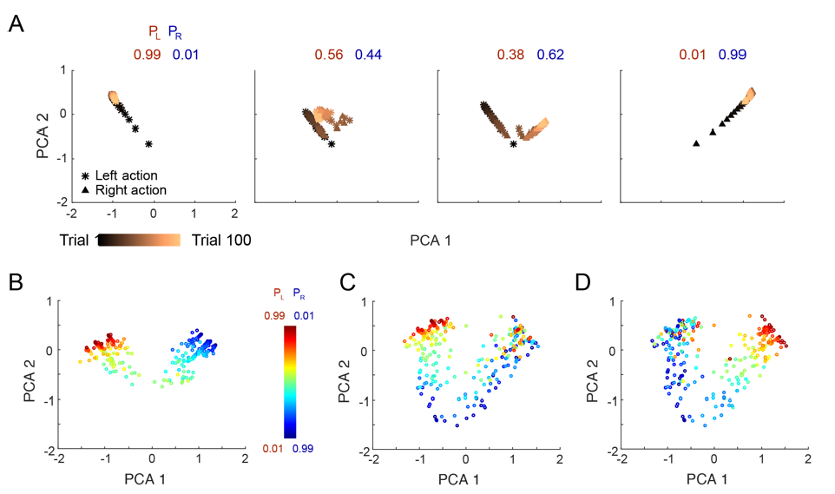
Results
A) Evolution of RNN activation pattern during individual trials while testing on correlated bandits, after training with independent arm parameters.
B) RNN activity patterns from step 100 (episode completion) while testing on correlated bandits, across a range of payoff parameters.
p_{L}, probability of reward for action ‘left’,
p_{R} = probability of reward for action ‘right’.

Slide 12
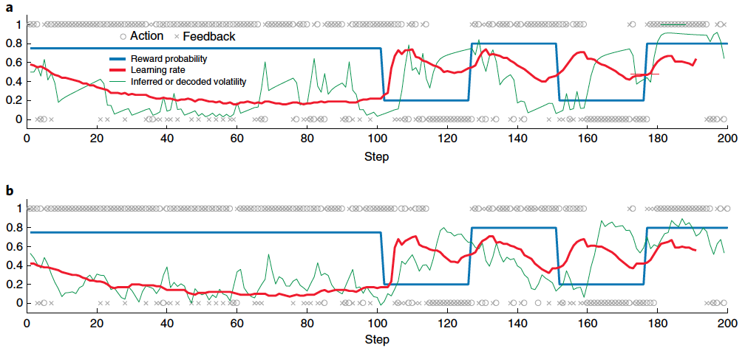
Results
Learned RL algorithm dynamically adapts its learning rate to the volatility of the environment.

Slide 13
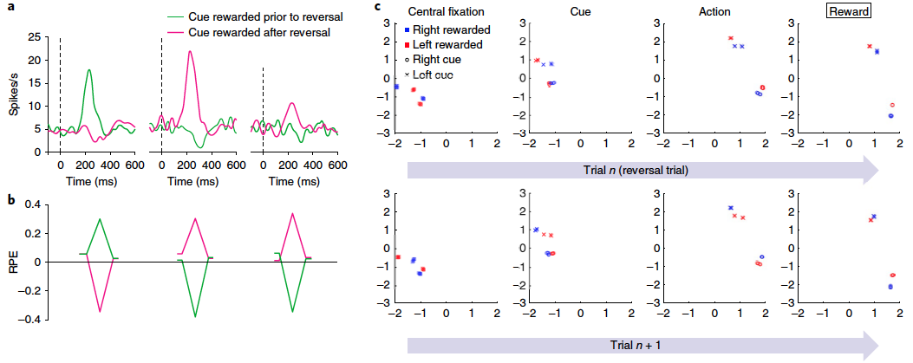
Results
Reward prediction errors of the simulated agent reflect inferred value, not just experienced value, similarly to what is observed in monkeys.

Slide 14
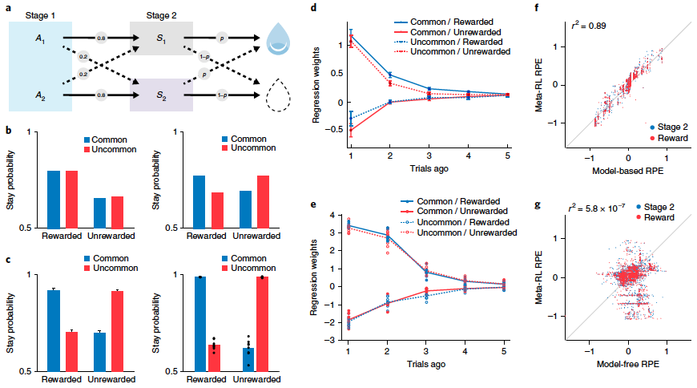
Results
Learned RL algorithm displays model-based behavior and RPEs.

Slide 15
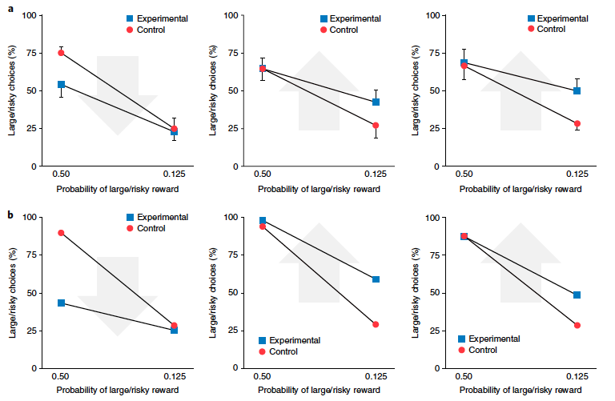
Results
Dual roles of dopamine: producing synaptic change for slow learning and carrying information about rewards for fast learning.

Slide 16
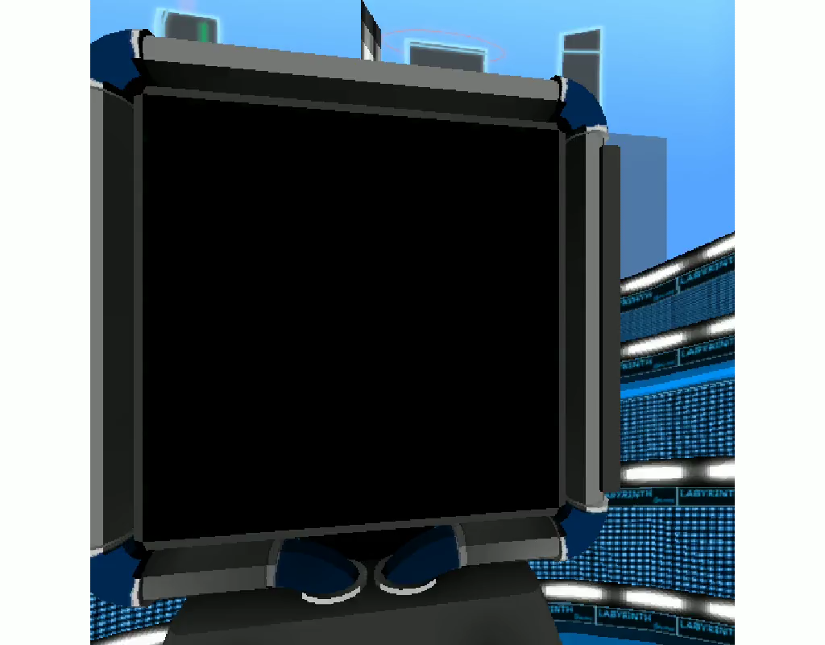
Results
Meta-RL learns to learn about abstract structure and novel stimuli in a visually rich 3D environment.

Slide 17
Conclusion
The meta-RL framework suggests that the role of PFC in model-based control could arise, at least in part, from DA-driven synaptic learning.
Meta-RL attributes model-based dopaminergic RPE signals to value inputs from the prefrontal network.
Further predictions might be specified by examining the patterns of activity arising in the prefrontal network portion of our model, treating these as predictors for neural activity in animals performing relevant tasks.

Slide 18
Perspectives
What might be the relative roles of mesolimbic, mesocortical and nigrostriatal DA pathways in a meta-RL context?
Does meta-RL point to new interpretations of the division of labor between dorsal and ventral, or medial and lateral, sectors of PFC?
What new dynamics emerge when meta-RL is placed in contact with mechanisms subserving episodic memory?

Slide 19
Useful links
Source codes:
https://github.com/xuejianyong/algorithms/tree/main/meta_learning
Overleaf link:
https://www.overleaf.com/8388341332cvnhnwktqfsd

Slide 20
Merci

Slide 21
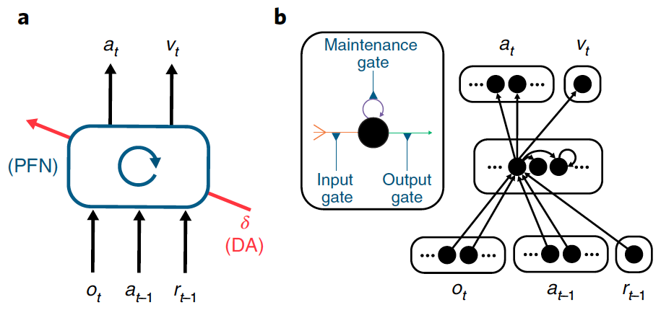
System architecture
This network’s inputs include perceptual data, which either contains or is accompanied by information about executed actions and received rewards. On the output side, the network triggers actions and also emits estimates of state value.
Agent architecture. The prefrontal network (PFN) is modeled as a recurrent neural network, with synaptic weights adjusted through an RL algorithm driven by DA; o is perceptual input, a is action, r is reward, v is state value, t is time-step and δ is RPE. The central box denotes a single, fully connected set of LSTM units.

